Slide 1



PIE Application Architecture
Nov - 2025
Proprietary and Confidentiality
THIS DOCUMENT CONTAINS PROPRIETARY AND CONFIDENTIAL INFORMATION OF APTUS DATA LABS, AND SHALL NOT BE USED, DISCLOSED OR REPRODUCED, IN WHOLE OR IN PART, FOR ANY PURPOSE OTHER THAN EVALUATION AND REFERENCE, WITHOUT THE PRIOR WRITTEN CONSENT OF APTUS DATA LABS. DISCLOSING THE SAME TO ANY PERSON, AGENCY, OR ORGANIZATION WHOM APTUS DATA LABS WOULD DEEM TO BE ITS COMPETITOR, WOULD BE CONSIDERED AS VIOLATION OF CONFIDENTIALITY.
‹#›

Slide 2



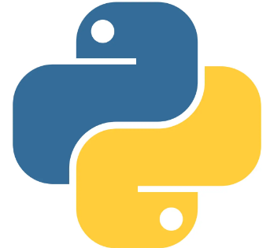
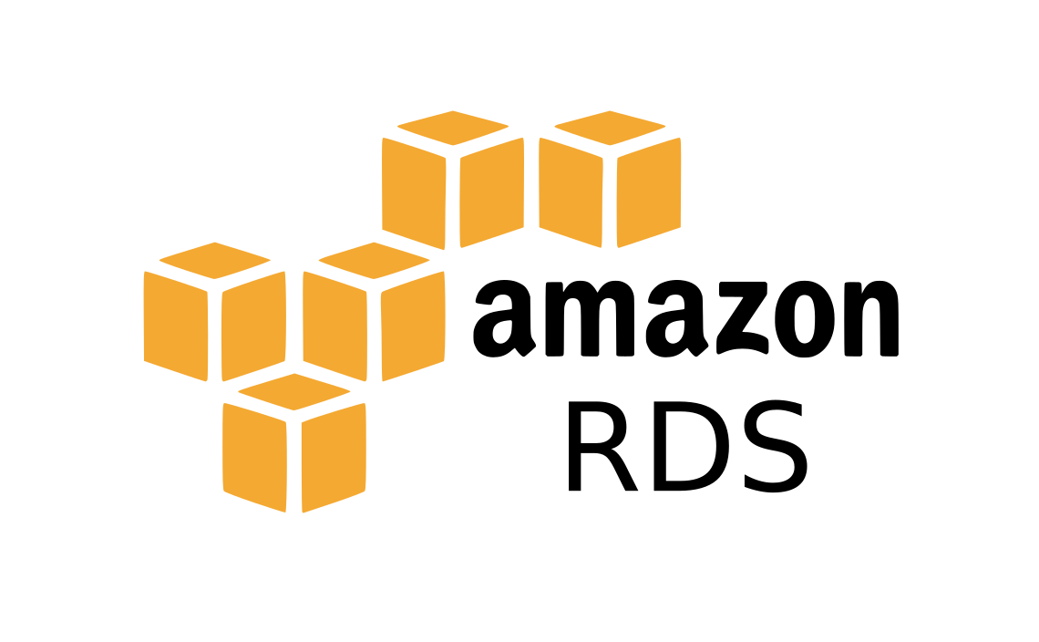



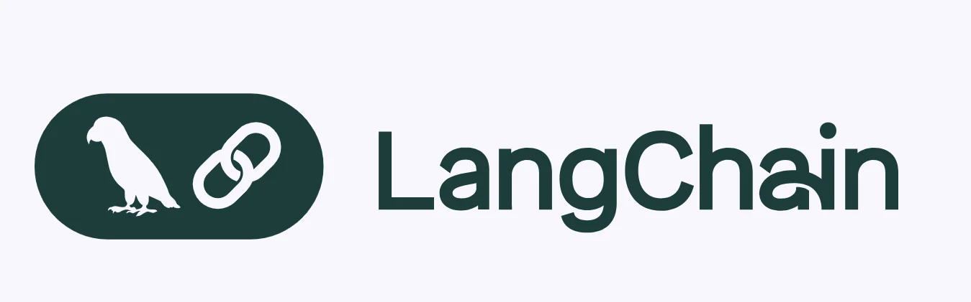



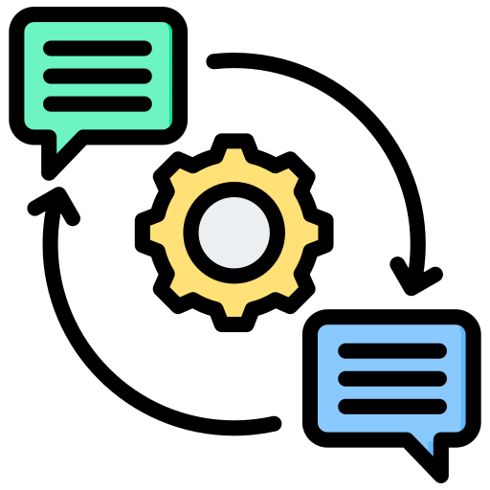

















Pie Architecture: Enterprise-Grade Conversational Intelligence
**Confidential**
User Interface Layer
Data Integration Layer
Preprocessing Layer
Web UI
SSO / OAuth 2.0 / RBAC Authentication
Secure connector pull data from Enterprise docs, databases, CRM, SCM, ERP, API, Cloud Storage (S3, RDS etc.) and external API’s with defined access.
• Cleaning
• Metadata Tagging
• Chunking
Feedback Loop Layer Learning & Adaptation Engine
LLM / Agentic AI
Agent Orchestrator
(Agentic AI)
Knowledge & Data Layer
Security Layer
• Capture thumbs/down + comments
• Logs to feedback DB
• Used for prompt tuning / model improvement
Knowledge Access Layer
• Secure Vector Database
• Embedding Models
• PostgreSQL (Metadata Mgt.)
Secure Data Cache / Temporary Store
• Plans multi-step actions
• Manages communication, coordination, and task allocation among agents.
Specialized Agents
SOP
QA
ERP
HR
Object Storage
• Implements RBAC and SSO for secure access control.
• Implements OAuth 2.0 for secure user authentication and authorization.
• Audit logs of queries, sync, feedback
• Uses AES-256 for data at rest and TLS 1.3 for data in transit.
CRM
Finance
R&D
Cloud & Hybrid Environments
Prompt & Safety Engineering
LLMOps
Testing and
Evaluation
Debugging
Traces
Prompt
Management
Monitoring

Slide 3
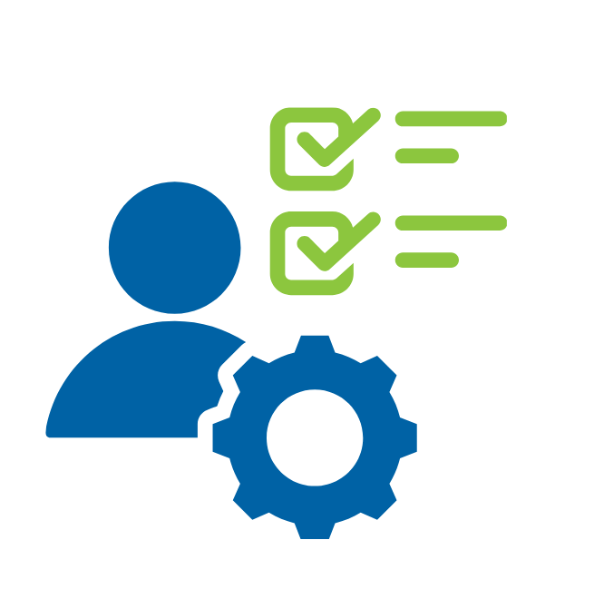


Mapping Role from Active Directory(AD)
A comprehensive mapping process connects each role present in the LDAP server to the role table within PIE DB, ensuring seamless synchronization between authentication and authorization systems.
AWS RDS
Role Discovery
Role Mapping
Permission Mapping
The complete list of all roles is first fetched from the LDAP server
Mapping the roles present on the client side with the role present on PIE’s database
Associating the required permissions with the particular role

Slide 4


Pie RBAC User Authentication Flow
SSO
**Confidential**
Enters Credentials
Users
Sends to DB
Role
User
Fetches the user information from Entra ID
Permissions
LDAP Server
Agent
JSON
Web Tokens
Validated
Department
Sub- Department
GPT- Store
Upon successful login, the system verifies the user’s credentials against the roles and permissions stored in the database. A payload is then generated containing the user’s RBAC permissions, including agent access, GPT-store access, and department/sub-department access.
Checks the user role
Agent Orchestrator
(Agentic AI)
Chatbot
AI Services
Admin Interface Features
Dashboard
Admin Interface
Departments, Sub-Departments,
GPTs, Agents

Slide 5
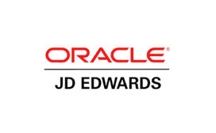








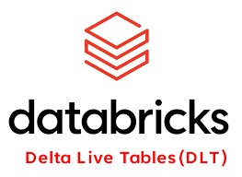
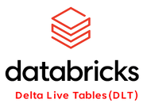
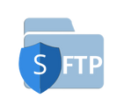
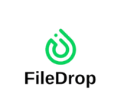


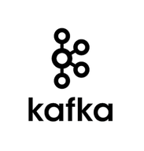

Amneal GPT Integrated Architecture
**Confidential**
INGESTION
Consumers
CRON Jobs
BRONZE (Landing/Raw)
API’s / JDBC
SILVER
Structured
Streaming
Unstructured Ingestion
(PDF / DOCX / PPT / Video / Audio)
PROCESSING
Apps (Amneal GPT, BMR Review, Smoke Study)
GOLD
DATA LAKEHOUSE

Slide 6





GPT Store Access: Unified Gateway for AI Services
Authenticate Users via Azure Entra ID and obtain the ID token and access token
**Confidential**
Microsoft Entra ID
Microsoft SSO
GPT Store
Use the token to enter the user to the GPT application without having to sign in again
Roles, and Permissions are fetched
RA Buddy
Store the authentication state using JWT Tokens
PIE Database (Auth)
BMR Assistant
Log in
Configure the GPT application to trust the Azure Entra ID tenant ID
Enable token sharing between the GPT applications and PIE
R&D Literature Searcher
Client
Chatbot
GPT
Application

Slide 7







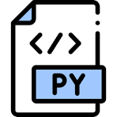


Agent Development and Orchestration
Define Objective
What the agent must do / achieve?
Select Agent Pattern
Reactive, Planning, etc
Select Framework
Agents can be created locally using PIE’s agentic frameworks or developed on low-code/no-code platforms like n8n or Zapier. Once tested and validated, they can be registered in PIE’s Agent Registry and seamlessly integrated into any organization through APIs or webhook connections.
Agent Orchestrator
(Agentic AI)
Langgraph or No code-low code agentic ai development kit
Set Up Environment
(APIs, DBs, Tools)
Configure APIs, databases, and tools the agent will operate with
Integrate LLM
Connect the agent to an LLM to enable reasoning and decision-making.
Agent-1
Add Memory/ RAG
Equip the agent with memory and retrieval for contextual intelligence.
Agent-2
Configure Actions &
Tools
Define the functions and tools the agent can execute autonomously.
Agent-3
Testing & Iteration
Evaluate and refine the agent through simulations and feedback loops.
Powered by :
Deploy & Monitor
Launch the agent with ongoing monitoring for performance and safety.

Slide 8
PIE End-to-End Agent Orchestration Flow
**Confidential**
User Interface Layer
JSON
Web Tokens
Validated
Chat Screen
User Types Prompt
Web UI
SSO / OAuth 2.0 / RBAC Authentication
Agent Orchestrator
(Agentic AI)
Policy-Driven Prompt Routing Logic→ Role and department from JWT determine query permissions • Department GPTs use isolated Pinecone namespaces • Trusted external fallback if no internal answer
Feedback Loop Layer Learning & Adaptation Engine
• Plans multi-step actions
• Manages communication, coordination, and task allocation among agents
• Prompt routed by orchestrator
• Capture thumbs/down + comments
• Logs to feedback DB
• Used for prompt tuning / model improvement
QA
ERP
HR
Specialized Agents
SOP
CRM
Finance
R&D
LLM Search
LLM / Agentic AI
Answer
Post Processing
Prompt & Safety Engineering

Slide 9
Amneal-GPT: Internal vs External Search Orchestration
Ṅ
User Query
Agent Orchestrator
(Agentic AI)
Response
User
Interface
Layer
Routing the user query to the respective department
Agents
Agent | Search Method | Remarks
Pharma-Research | Complete Internal DB Search + fallback → external web search | Internal Diabetes Research data (AWS S3) + External websites Model used : GPT-4o-nano, Google API
RA Deficiency | Complete Internal DB Search + fallback → external web search | Internal ANDA, RA Data (AWS S3) Model used: GPT-4o-mini , Google API. External Search can be configured if needed.
General queries | Real time LLM web search tool + LLM Knowledge Search | For general queries independent of Enterprise data Model used : Google API, GPT-4o-mini ,
New Agent | Configure the search flow based on the use case | Models: Any Enterprise Models/ Hybrid Models/ Custom Models can be used
Roles
Admin
Content Manager
Business User
Nth Role

Slide 10


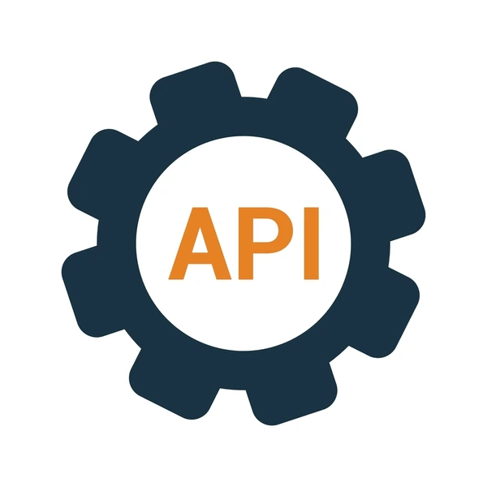


Amneal-GPT: RBAC Architecture and Data Sources
JSON
Web Tokens
Validated
Data Sources
Policy-Driven Prompt Routing Logic→
- Role and department from JWT determine query permissions. - Mapping tables: User_id, role, permission, object, vector namespace - Department GPTs use isolated Pinecone namespaces - Trusted external fallback if no internal answer
Internal
Departments
Organization Roles
Admin Portal / Chatbot
Pharma-
Research
Admin
Diabetes Research data (AWS S3), External websites (medscape, pharmatimes, etc
Agent Orchestrator
(Agentic AI)
Content Manager
Regulatory Affairs
Agent
Hub
Web UI
Business User
When user types the prompt, orchestration engine determines agent to be assigned and which database to be sourced
PIE uses NLP/ Semantic algorithms/ LLMs to determine context.
Relevant LLM/Model executed.
Post-processing steps executed.
Output results presented
Database access governed by roles
Internal ANDA, RA Data (AWS S3)
SSO / OAuth 2.0 / RBAC Authentication
Other Databases
External
User Interface Layer
Nth Role
Nth Department

Slide 11
Agent Factory
Build & Connect Agents
Model Workflow as
- Domain Specific (e.g. Finance, HR)
- Technical (e.g. DataOps, Automation, MLOps)
Monitor & Improve
- Evaluation Testng
- Performance & KPIs
Define Business Need
Agent/Tool Registry
Deploy & Automate
Enterprise Systems
(Databases, APIs, CRM/ERP)

Slide 12



RAG Framework: Vector Database Indexing
**Confidential**
{
"anda_no": "1234",
"medicine_name": "xyz",
"deficiency_response_data": "xx-yy-zz",
"country_code": "xyz",
“document_remarks”: “xyz”,
“department”: “dept x”,
“document_source”: “s3://….document”
}
Each department/ Sub Department has its own key parameters that are useful for responding to user queries such as ANDA number and medicine name for the Regulatory department. Similarly, for the HR department, it might be policy number, policy category, etc. Metadata tagging helps improve retrieval accuracy by applying filters during chunk retrieval, which reduces the search space and returns the most relevant chunks.
*Vectorization
* Incoming File Upload/ Modification → Parsing Trigger → Parsing Pipeline → Source + Document
Document Parser
Chunking
Metadata tagger
The document is split into smaller parts with header structure preserved, along with basic metadata like document_source and upload_date.
Metadata Tagging( DEPARTMENT_TAGGER_REGISTRY)- capturing key parameters to enhance retrieval accuracy.
Cloud (S3/GCS/Azure/MinIO)
Non-Cloud (File Server/SharePoint/DB)
The uploaded document is checked in the document registry for previous versions.
Document Registry
Internal & Historical Data Sources - Ad-hoc Uploads
Documents
Functions as a Knowledge Repository capturing key details of a document (department, confidentiality, scope) while enabling version control and dynamic updates **CRUD operations to the vector DB.
For historical data that already exists in the database, uploads (bulk uploads) will be handled during the initial setup and configuration of the department-wise chatbot using tools like S3 Event Notification, Pub/Sub Notifications, Event Grid etc

Slide 13

RAG Retrieval Process: Metadata Filtering
**Confidential**
Agent Orchestration rephrases the query using chat history and routes it to the appropriate department, sub-department, and agent based on the user’s RBAC.
The query is searched in the vector database using the applied filters, which further reduce the search space and improve the accuracy of document retrieval.
Meta Data Filter
{
"medicine_name": get_medicine_name(filename),
"anda_number": get_anda_number(filename),
"country_code": get_country_code(filename),
"deficiency_response_date": get_deficiency_response_date(filename)
}
Agent-Orchestration
Agent Selection
Vector-DB
Each agent has its own set of information, such as an index, database, and namespace, that it searches. This helps reduce the overall search space for the system.
Re-ranking
The metadata filter is dynamic and extracts keywords from the normalized user query. The type of keywords to be extracted is defined as a custom state for each department and sub-department. For example, in the regulatory department, metadata such as ANDA number and medicine name are set as defaults. Similarly, each department has its own defined metadata filters.
User Query
Chunks Retrieved
The retrieved chunks are of highest match score

Slide 14

Feedback Loop: Retrieval Augmentation Fine Tuning(RAFT)
LLM Providers
**Confidential**
User Query
Google/Anthropic/OpenAI
If accuracy increases model is upgraded and re-deployed
Custom LLM Model
Chatbot Response
Evaluation over ground truth data
Data point created and added to the database
Threshold = 1500 + data points
Threshold = 2000 + data points
Evaluation Scores
Fine-tuning
Fine Tuning Data set
Feedback Grader
Feedback Database
Feedback Loop Layer Learning & Adaptation Engine
Cosine Similarity
Recall@k
Custom Rubrics
1- The copy of the deployed llm is fine-tuned.
2- The data is kept private and safe
1- Prompt + User_Query+ Retreieved_data + Ideal response
2-All collected feedback is reviewed and analyzed by OpenAI’s teams and systems. This data helps identify weaknesses, improve accuracy, and enhance safety, but it is also processed with privacy in mind (personal information is minimized before training).
1- Grading done by Human evaluator / LLM Evaluator( GPT-4-x)
2- Classification of feedback to genuine or not genuine
1- Prompt + User_Query+ Retrieved_Data + Generated_Response + user comments + Agent Used, etc.
1- Capture thumbs up/thumbs down + comments + other information
2- Logs to feedback Database
3- Used for prompt tuning / model improvement
Feedback Data Collection

Slide 15






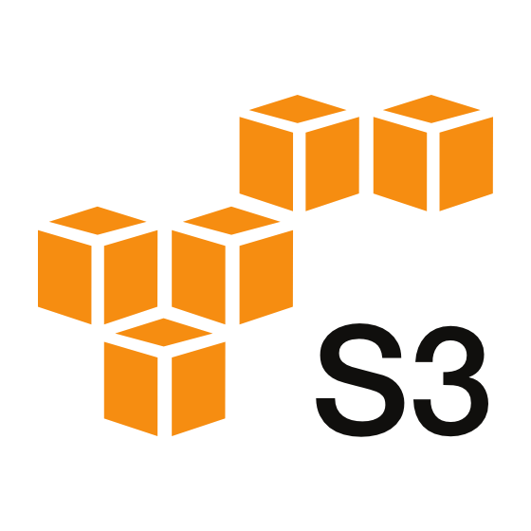


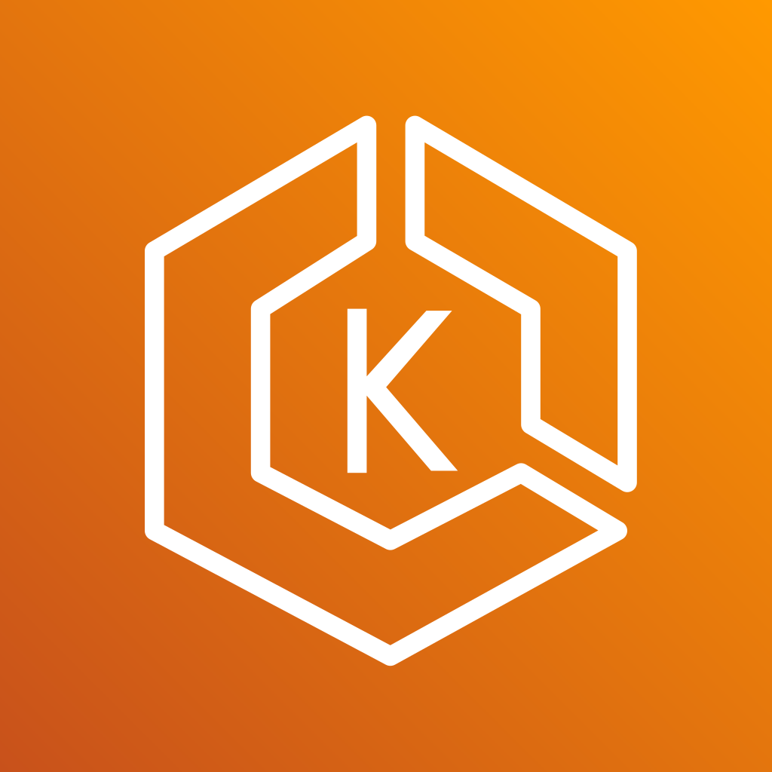

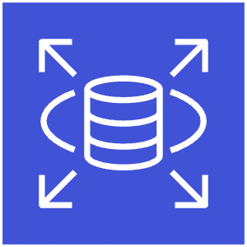
Cloud & Security Architecture
Our comprehensive cloud infrastructure leverages AWS services to deliver a secure, scalable, and high-performance platform. This architecture integrates authentication, data management, and AI services in a cohesive ecosystem designed for enterprise-grade reliability.
A multi-layered security framework protects data, users, and services through encryption, access controls, network isolation, and continuous monitoring. Our defense-in-depth approach ensures comprehensive protection at every level.
AWS Region
HTTPS Connection
TLS/SSL
Public Subnet
Private Subnet
AWS Certification
Manager
AWS Route 53
AWS WAF
NAT Gateway
ALB
EKS
Fargate
RDS
S3

Slide 16
Enterprise AI Platforms Overview: Positioning PIE
S.No | Capability / Requirement | Microsoft Copilot | ChatGPT (OpenAI) | Pie (Precise. Intelligent. Experience.)
1 | Quality of RAG (Retrieval-Augmented Generation) | M365- optimized; high precision in SharePoint/Outlook; limited adaptability or metadata control. Custom metadata configuration not possible. | Web RAG; weak dataset grounding and retrieval transparency. Custom metadata configuration not possible. | Enterprise-grade RAG tuned per department and use case; multi-agent pipelines (HR, Finance, SOP, QA, R&D, Data Analysis etc) with continuous feedback and hybrid retrieval from internal + external sources. Custom metadata configuration makes retrieval more accurate.
2 | Ease of Use (UX) | Smooth for M365 users; minimal setup; limited agent view or dev control. | Easy chat UX but limited visibility or workflow control. | User-friendly unified workspace for building, orchestrating, and testing multi-agent systems and connecting multiple AI services from one interface.
3 | Role-Based Access Control (RBAC) | Inherits Azure AD roles; limited granularity and lacks agent-level or dataset-specific access. | Basic account-level access; not fine-grained ( no dept level, sub dept, agent level control.) | Fine-grained control across department, sub-department, agent, document level (*confidential documents) with SSO, OAuth2, and full audit logging.

Slide 17
Enterprise AI Platforms Overview: Positioning PIE
S.No | Capability / Requirement | Microsoft Copilot | ChatGPT (OpenAI) | Pie (Precise. Intelligent. Experience.)
4 | Agent Marketplace / Agent Handling | No open marketplace; limited to prebuilt Copilot experiences within Microsoft apps. | Custom GPTs/plugins; lacks governance & versioning. | Integrated agent marketplace, orchestration hub & Agent Factory; supports custom agents, independent AI microservices, and transparent evaluation within secure boundaries.
5 | Integration with Internal Data & Custom AI Store | Deep integration with Microsoft Graph, SharePoint, OneDrive, Azure data sources, and custom connectors. | Limited to OpenAI models with prompt tuning and fine-tuning capabilities only | PIE seamlessly connects to data across DataLakes, AWS, Google, CRMs, ERPs, and On-Prem systems through modular API layers and MCP servers, enabling a unified, dynamic enterprise AI environment.
6 | Customization & Flexibility | Moderate flexibility staying within Microsoft ecosystem boundaries | Minimal customization; prioritizes simplicity and fast deployment over configurability. | Fully configurable workflows and agent behaviors; supports fine-tuning, adaptive pipelines, and integration with proprietary or open-source models.

Slide 18
Enterprise AI Platforms Overview: Positioning PIE
S.No | Capability / Requirement | Microsoft Copilot | ChatGPT (OpenAI) | Pie (Precise. Intelligent. Experience.)
7 | Scalability & Performance | Scales within Microsoft Cloud; limited infrastructure control. | Auto-scales in OpenAI Cloud; minimal control over resources. | Elastic scaling with smart routing, dynamic orchestration layers and caching for real-time, cost-efficient performance.
8 | Business Use Case Integration | Best for businesses on Microsoft ecosystem only. Vendor lock-in. High dependence on a single provider. | Useful for web and API-based use cases, but limited infra choices. Reliant on OpenAI’s cloud and architecture. Less control. | Fits hybrid and multi-cloud needs: on-prem, cloud, or both. Deploy via Kubernetes-based microservices. Business gains control to deploy and integrate across ALL environments, avoids lock-in, enables regulatory compliance and resilience, adapts as needs change.

Slide 19
PIE: Performance Evaluation & Monitoring
**Confidential**
System Evaluation
In the Agent Evaluation, each agent is assessed independently. Eg., For RAG-based agents, the evaluation focuses on the core RAG components: retrieval, context, and response quality, using metrics such as Cosine Similarity, BERTScore, Recall@K, and RAGAS (covering conciseness, completeness, and moderation checks).
Other agents, such as the analysis agent, are evaluated through LLM-as-a-Judge for tasks like Excel analysis and code generation accuracy. Additionally, latency evaluation is conducted across versions, and any significant deviation beyond a predefined threshold triggers optimization measures to maintain performance and efficiency.
Post-deployment, user feedback is analyzed and categorized into Agent Feedback and Orchestration Feedback. Agent-specific feedback is mapped to the respective agent and logged in the Feedback DB.
Each agent is monitored for drift, latency, accuracy, and performance. The orchestration layer is also evaluated for routing quality and decision accuracy. When drift or inefficiencies are detected, corrective actions such as prompt tuning or fine-tuning are applied to ensure optimal system behavior.
Agent Evaluation
Orchestration Evaluation
Retrieval Eval.
Tool/Agent Selection
Response Eval.
Moderations
Context Eval.
Latency
Hallucinations
Feedback
Moderations
Latency
Feedback

Slide 20



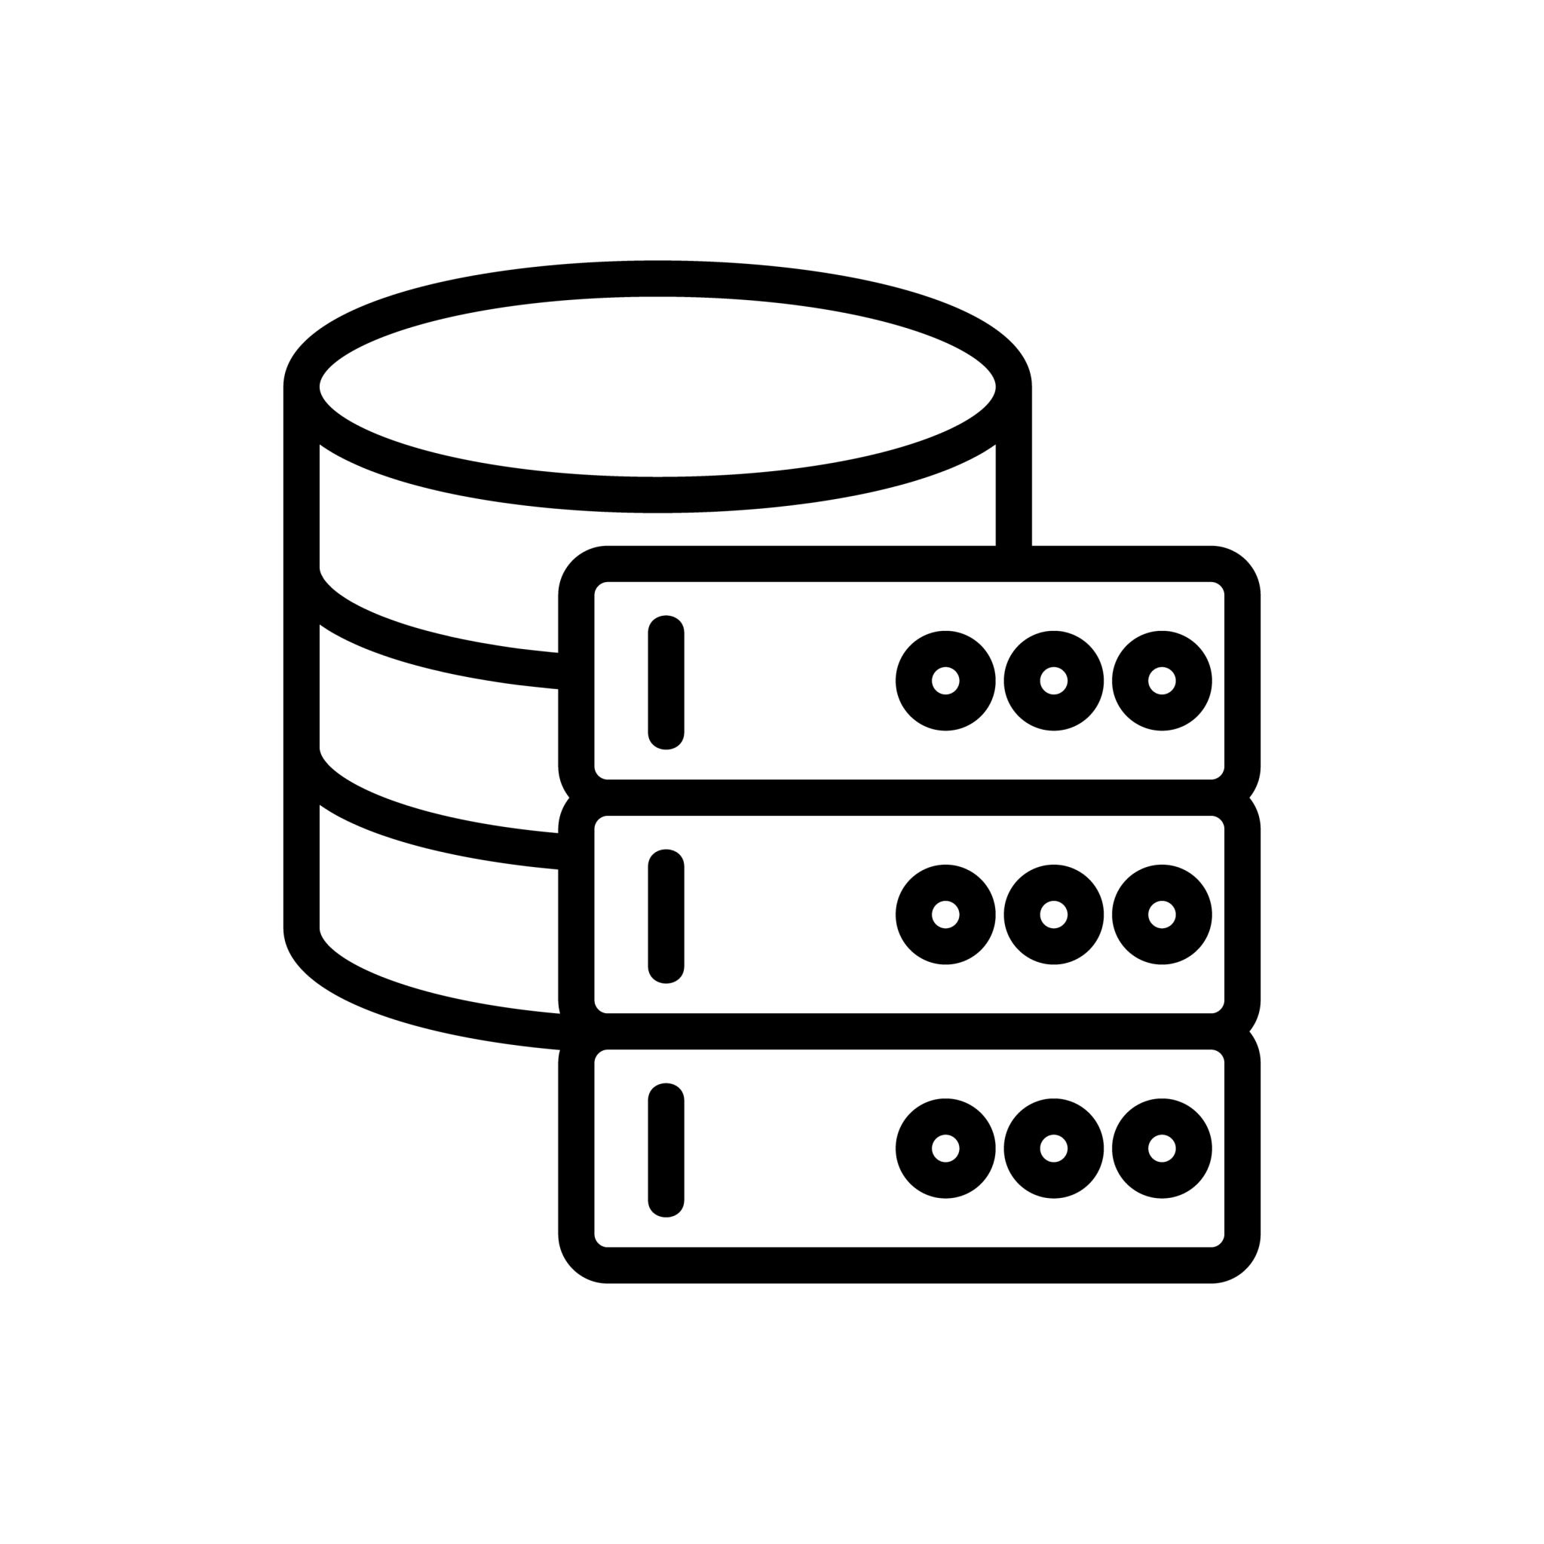
Audit Logs & Monitoring
Prometheus
Grafana
Observable Logs
Loki
Application Services
Loki Storage
Audit DB
Audit Service
Audit Processing
Audit Logs shown in UI
Application metrics are collected by Prometheus and visualized in Grafana.
Application logs are aggregated through Loki and stored in Loki Storage, where Grafana can also visualize them.
Separately, audit events are processed through a dedicated audit logging service, stored in an audit database, and displayed in the application UI.
For AWS services logs monitoring Cloudwatch will be utilised

Slide 21

Q&A

Slide 22
PIE: Roadmap

Slide 23
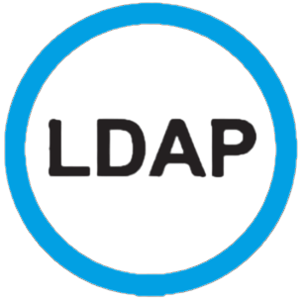
Pie RBAC New User Single Sign On
User
All the access added on the UI will be stored on RDS
Admin logs in and then goes to the Roles page and start assigning roles
Section | Create | Read | Update | Delete
Organization
GPT Store
Departments (dynamic)
Sub- Departments (dynamic)
There will be a constant talking between the database and the LDAP server
Roles Page
Users
SSO
Users Role
Org user’s information are stored in the LDAP server
Ṅ
GPT Store
PIE
Agents
The credentials are validated against the existing info
Department
Sub-Department
Users are fetched from database to PIE UI users page
Once the authentication is successful a token is generated and sent back to the auth service

Slide 24


Data Integration: Database Connectors (MCP, APIs )
Knowledge Base Layer
MCP, APIs
Database Setup
CRM, ERP systems
Documents
Link to Tool/ Agent
Internal & Historical Data Sources - Ad-hoc Uploads
The database setup part is used for initial Data Load- Data Transform operation for RAG Use Case based on similarity searches. For connecting to other internal dbs like CRMs, ERPs, MCP, API endpoints are configured inside the agent knowledge store
Document Parser
Document Registry
Chunking
Metadata tagger

Slide 25
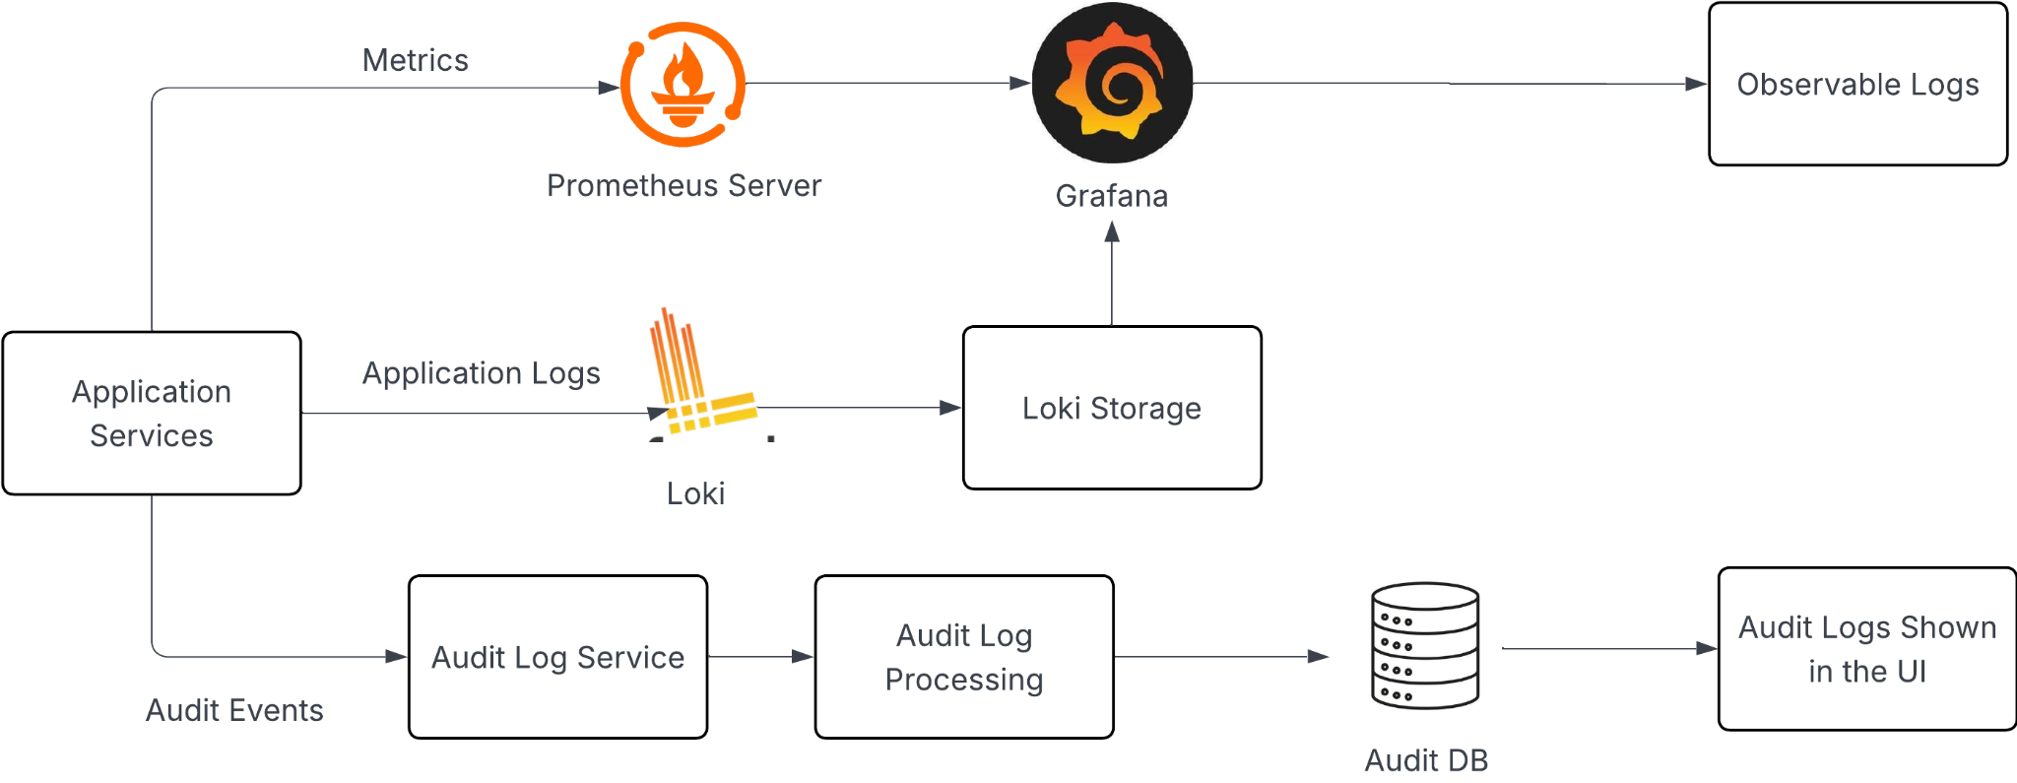
Audit Logs & Monitoring

Slide 26
Automated Testing of PIE Functionality
Authentication & API Testing
Functional Testing
Login and Authentication Testing
End-to-End User Flow Testing
API Testing
Database Validation
Release & Stability Testing
Deployment Testing
Regression Testing

Slide 27
Automated Testing of PIE Functionality
Login & Authentication Flows
Automation of login with SSO/OAuth to validate authentication behavior.
Checking of successful redirection and access to protected pages
Ensure seamless integration of SSO between multiple integrated applications
API Response Validation
Automation of testing of REST endpoints of the application
Validation of the proper status codes and payload data that are being fetched from the APIs
Validation of data accuracy, error codes and schema handling.
Validation of performance metrics (response time)

Slide 28
Automated Testing of PIE Functionality
Testing of full User (End-to-End Flows)
Automation of a real-world interaction of user such as (creation of a new role, creation of a new user etc.)
Validation of the steps
Detection of breaking changes that affect the flow
Database Validations
Validation of proper database queries
Check if the database constraints are properly applied
Comparing the data from an API response along with the data that is stored in the database to check for the integrity and correctness of the data

Slide 29
Automated Testing of PIE Functionality
Deployment & Regression Checks
Automated test suites would be run during the CI/CD pipelines execution to ensure continuous quality assurance
Verification of the new changes would be done, so that they do not break the existing features (regression checks)
Overall Application Testing
Testing of the application under network failures and service downtime
Simulation of edge cases and testing the application against those cases.
Ensuring graceful handling of errors
Testing the application against heavy user traffic to test its performance and robustness
Vulnerability assessment of the application

Slide 30
Mapping Role From Active Directory(AD)
A mapping is made with each role present in the LDAP server to the role table present in PIE DB
AWS RDS
LDAP Server
In RDS, each role is assigned specific permissions such as Create, View, Update, and Delete, along with access to specific agents and namespaces.
User information is stored in Entra ID
The LDAP Server contains the user information(including roles and groups)
The list of all roles are first fetched
03

Slide 31
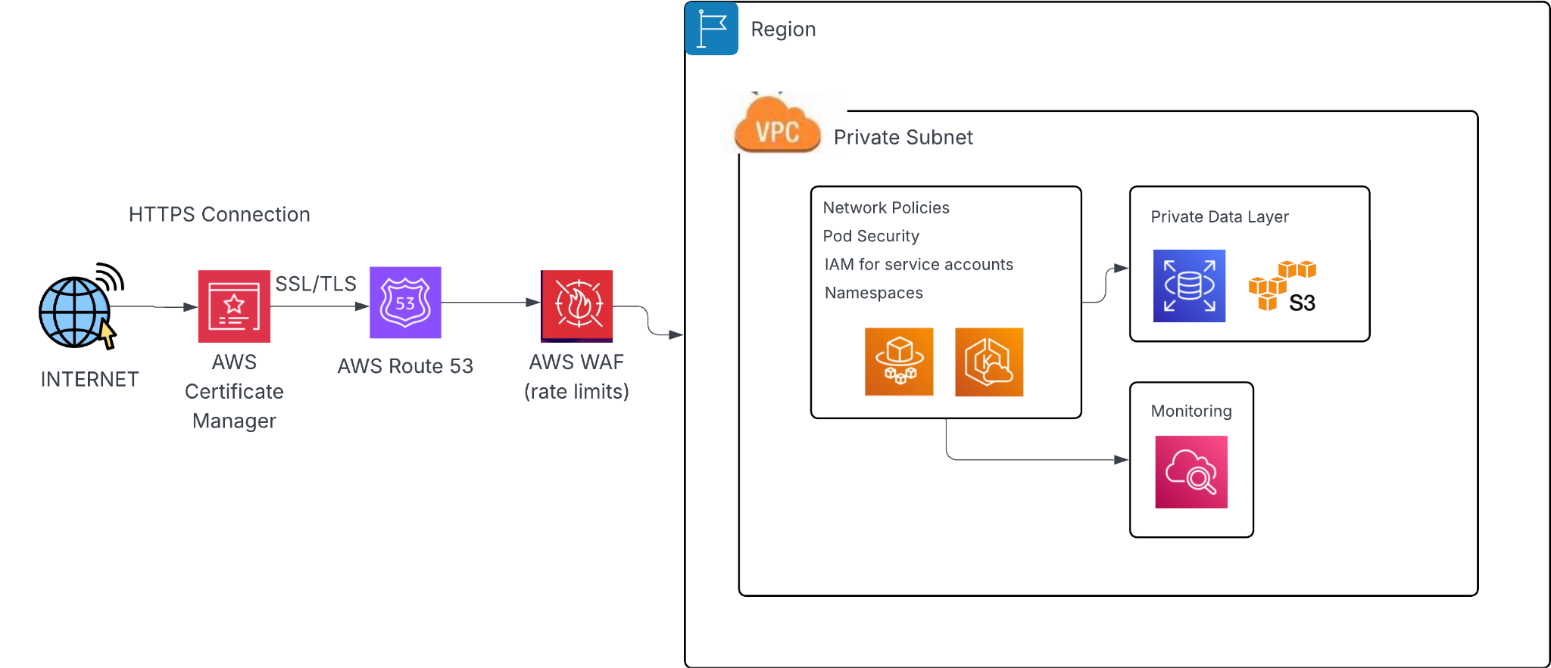
Security Architecture

Slide 32
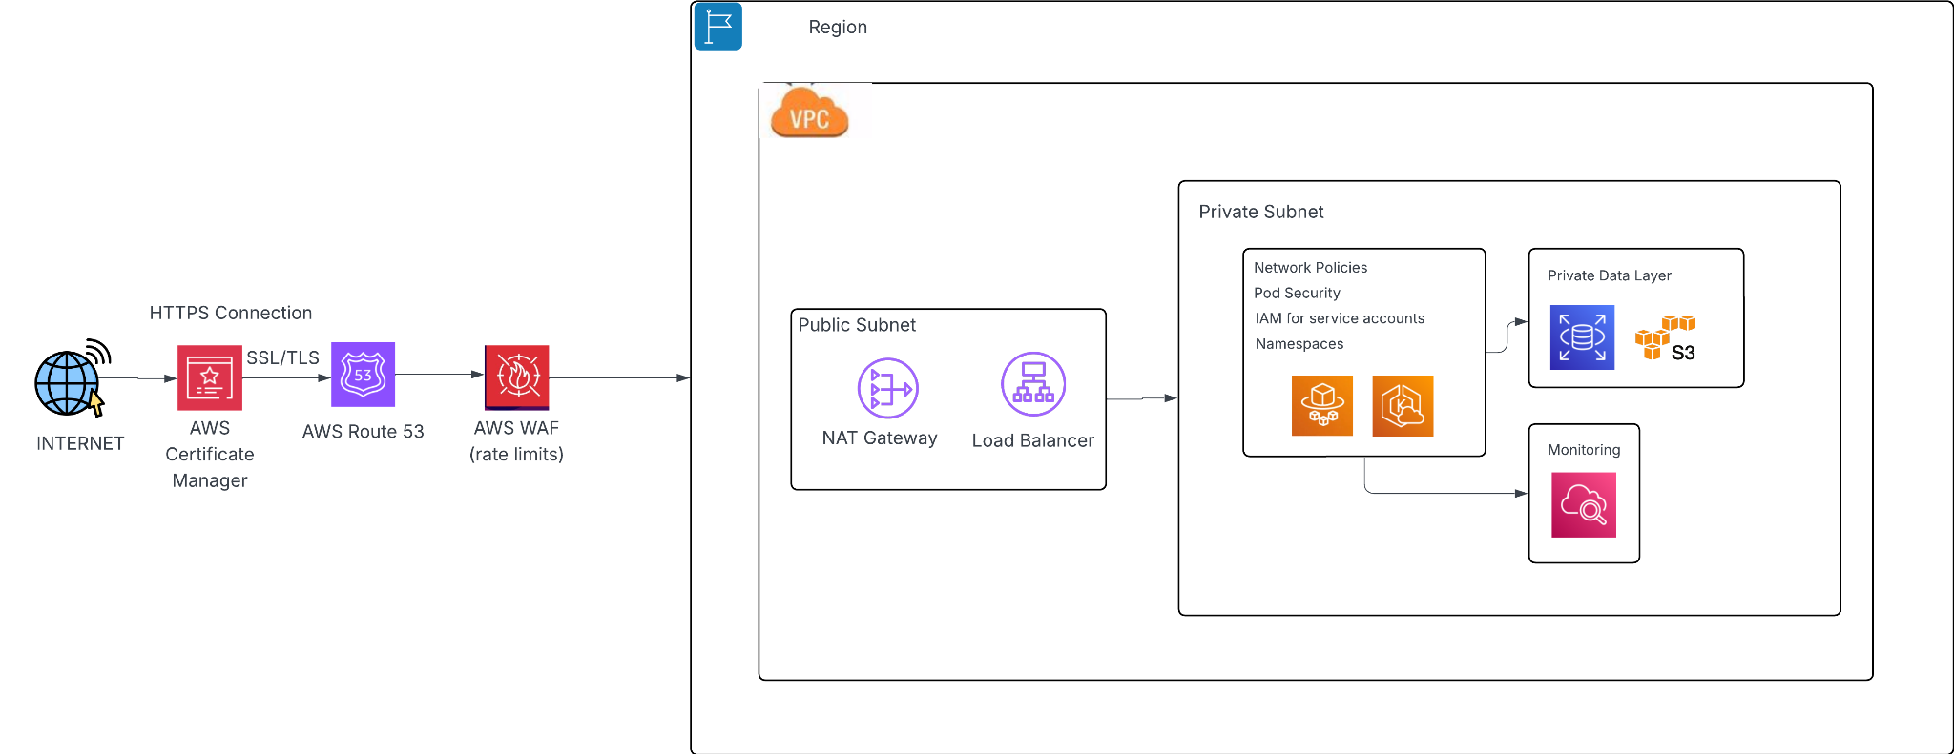
Cloud Architecture

